Slide 1

SMART PASSWORD ASSISTANT
Mentors,
PALLAVI KOGANTI
RASHMI PAI
BY,
GOWRI SANKAR P
RAMESH P R
ANJANA KRISHNA
DHANYA JOSE

Slide 2

CONTENTS
INTRODUCTION
PROBLEM STATEMENT
SOLUTION
DESIGN
TECH STACK
FUTURE SCOPE
ADVANTAGES
CONCLUSION

Slide 3
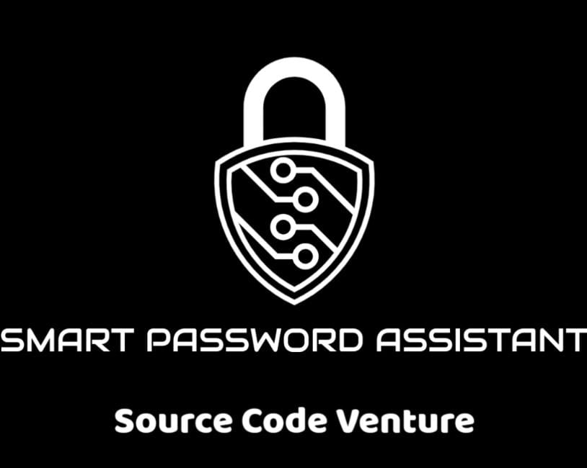
INTRODUCTION
The project entitled “Smart Password Assistant” is a combination of an automated python project and an android application.
The main purpose of this project is to increase security of wireless network to make them more secure and prevent external intervention.

Slide 4
PROBLEM STATEMENT
Do you think your home Wi-Fi is secure ?
Do you use a complicated router password
Do you frequently change your router password

Slide 5
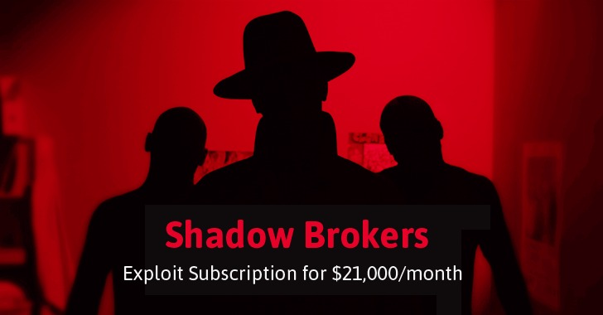



Why should I be Worried ?
We conveniently ignored the windows update, which inturn resulted in …

Slide 6

Proposed Solution
SMART PASSWORD ASSISTANT
Desktop and Android application.
Main Function
Automatic Password Updation
Sub Functions
Password Encryption
Chatbot - key transfer & Instructions check

Slide 7




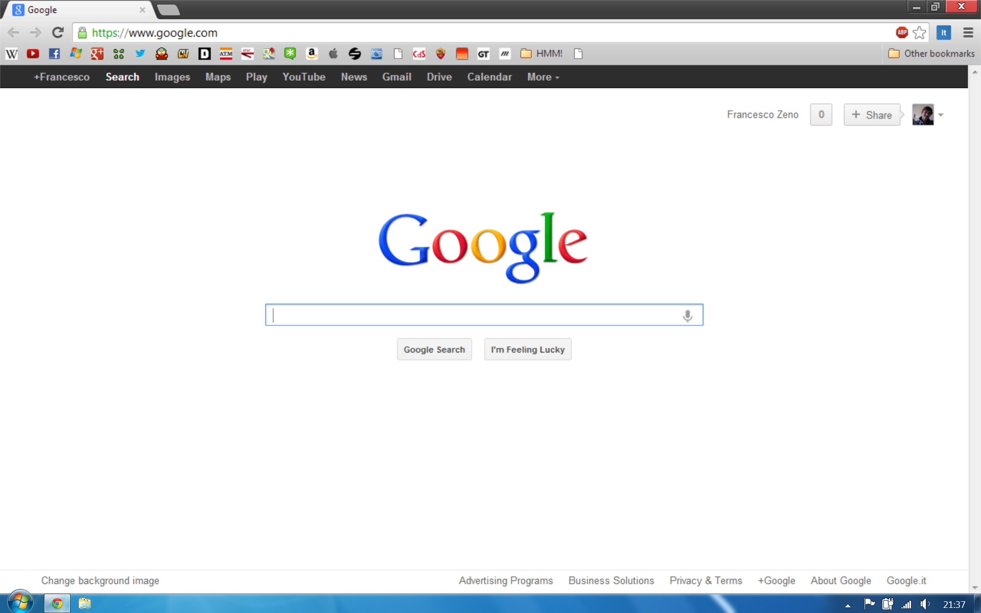
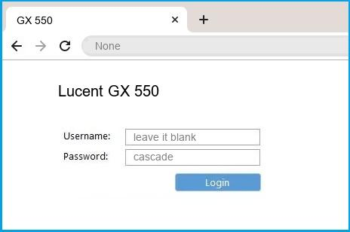
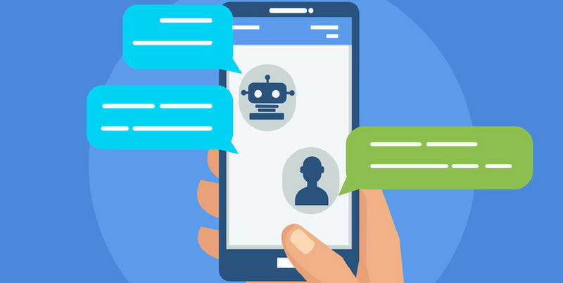

Block Diagram
Prepares a list of
strong password
passwords
Rockyou.txt
Provide input to chatbot
Compare the password with rockyou.txt
Python code
Sends encrypted password
Selenium web
driver
Router Administration
Web Browser
Smart password Assistant Engine
Decrypter

Slide 8
Tech Stack
Selenium Webdriver
Python
RockYou.txt
Whatsapp Desktop
Android Studio
Java

Slide 9
Advantages
Security of data
Password updation is a simpler task
It will reduce the time consumption
Efficient and Flexible
User friendly

Slide 10
Future Scope
User accounts can be implemented for Android Application.
Real time password set algorithm can be developed.
Algorithm can be developed further for social accounts password changing.
Chatbot implementation can be improved by :
SMS Communication for password transfer.
More network details check automation.
Notify the user to update passwords list.

Slide 11
Conclusion
Your home network is naturally vulnerable, which means the responsibility falls on you, the end user. To keep an eye out for signs of suspicious activity and figure out what to do if your network is hacked. Here we use the idea of “Smart Password Assistant”
By using this idea, we were able to create a more secure and trust worthy environment for the users.

Slide 12
Thank You
“Hey… Don’t worry! Now you have your SMART PASSWORD ASSISTANT with you. You are perfectly safe.”

